Slide 1
See quiz on humanaiclass.org
Ethics in Human-AI interaction

Slide 2
Before we begin
Please complete the pre-class questionnaire.
It is not graded.

Slide 3
Learning objectives
You should be able to:
Refute common complaints about bothering to think about ethics
Describe some distinguishing characteristics of reasoning through ethical questions in technology (“the making of things”)
Describe some systems for ethical thinking in relation to technological decisions
Reason about whether some AI interactions are ethical or otherwise

Slide 4
What is our role as technologists?
“I feel like when every technology is developed, then there is this danger of with our technology, you -- you can create fake videos and so on…. the way that I think about it is that, like scientists are doing their job and showing -- like, inventing the technology and showing it off, and then we all need to, like, think about the next steps, obviously.”
Notes:
https://www.wnycstudios.org/podcasts/radiolab/articles/breaking-news

Slide 5
Do we have to pick and choose what tech we create?
“I feel like when every technology is developed, then there is this danger of with our technology, you -- you can create fake videos and so on…. the way that I think about it is that, like scientists are doing their job and showing -- like, inventing the technology and showing it off, and then we all need to, like, think about the next steps, obviously.”
Notes:
https://www.wnycstudios.org/podcasts/radiolab/articles/breaking-news

Slide 6
Is this the right model for innovation? (What’s missing?)
Working fast and flexibly like a Silicon Valley startup (process)
Incorporating the latest technologies to transform the way we engage populations and measure everything (technology)
Taking user needs into account, make sure that solutions reflect real user needs (design)
New models of shared value partnership, thinking more like an ‘incubator’ than a serial-process driven system (investing)
Notes:
From the “Ethics of Innovation” https://ssir.org/articles/entry/the_ethics_of_innovation

Slide 7
Consent: should we ask for it?
“A faceprint or any information derived from the operation of a face recognition system may not be sold or shared except with the informed, written consent of the individual whose information is being sold or shared.”
Notes:
From the ACLU https://www.ntia.doc.gov/files/ntia/publications/aclu_an_ethical_framework_for_face_recognition.pdf

Slide 8
Consent: should we ask for it?
“Have you ever tried putting a consent form inline on your social site? I have, and I can tell you that it drives away a large proportion of interested people who would probably actually want to participate if the interface were different. It looks scary. It’s opt-in, and defaults are powerful. Forget that it’s there to protect people — it makes the entire site look like something underhanded is going on”
Notes:
From Michael Bernstein. https://medium.com/@msbernst/the-destructive-silence-of-social-computing-researchers-9155cdff659 (Note that the article suggests Michael’s perspective has changed over the years. Nonetheless, the excerpt above notes facts, not opinion.)

Slide 9
Should certain populations have restricted access to tech?
“Teens are particularly vulnerable to exploitation because they frequently use new technologies without a full understanding of the long-term consequences of that use.”
Question: should teenagers be prohibited from uploading pictures of their faces to systems that use facial recognition?
Notes:
From the ACLU https://www.ntia.doc.gov/files/ntia/publications/aclu_an_ethical_framework_for_face_recognition.pdf

Slide 10
Act utilitarianism
A person's act is morally right if and only if it produces the best possible results in that specific situation

Slide 11
Rule utilitarianism
A person's act is morally right if and only if it conforms to a rule that leads to the greatest good.

Slide 12
Deontology
The morality of an action should be based on whether that action itself is right or wrong under a series of rules, rather than based on the consequences of the action.
Cf social contract theory: a compact, or agreement, between the ruled and their rulers, defining the rights and duties of each determines what is morally right

Slide 13
Virtue ethics
An act is moral if it is virtuous
A virtue is ‘indeed a character trait—that is, a disposition which is well entrenched in its possessor, something that, as we say “goes all the way down”... ’ It requires the practically wise agent.
the practically wise agent’s [has] capacity to recognise some features of a situation as more important than others, or indeed, in that situation, as the only relevant ones
Practical wisdom can only come with experience (e.g. to know the likely consequences of certain actions for people)
Notes:
See more at https://plato.stanford.edu/entries/ethics-virtue/

Slide 14
Personal decisions
All these frameworks require a person to make the decision
Why?

Slide 15
Personal decisions
All these frameworks require a person to make the decision
Why?
Decisions without a person’s judgement have no responsibility.
Nearly any ethical frameworks disallows “I followed the rules” as a defense.

Slide 16
Who is to blame?
“in March 2018, a self-driving Uber was navigating the Phoenix suburbs and failed to “see” a woman, hitting and killing her... In the case of Uber, the person minding the autonomous vehicle was ultimately blamed, even though Uber had explicitly disabled the vehicle’s system for automatically applying brakes in dangerous situations.”
Notes:
From https://ainowinstitute.org/AI_Now_2018_Report.pdf

Slide 17
AI technology is problematic when it obscures who is making a decision

Slide 18
Are ethical guidelines helpful?
“...the technology should also meet a ‘proportionality’ requirement. That is, it can be permissible only if the benefits are proportionate to any loss of liberty and privacy.”
Notes:
By the Facial Recognition Working Group of the Biometrics and Forensics Ethics Group (Government of UK) https://assets.publishing.service.gov.uk/government/uploads/system/uploads/attachment_data/file/781745/Facial_Recognition_Briefing_BFEG_February_2019.pdf

Slide 19
Are there inherently unethical uses of technology?
“An entity may not use a face recognition system to determine an individual’s race, color, religion, sex, national origin, disability or age.”
Notes:
From ACLU https://www.ntia.doc.gov/files/ntia/publications/aclu_an_ethical_framework_for_face_recognition.pdf

Slide 20
What is to blame for unethical technological choices?
“... regulatory gaps exist because laws have not kept up with advances in technology. The gaps are getting wider as technology advances ever more rapidly.”
Notes:
By Vivek Wadhwa https://www.technologyreview.com/s/526401/laws-and-ethics-cant-keep-pace-with-technology/

Slide 21
Do ethics boards matter?
“It’s not that people are against governance bodies, but we have no transparency into how they’re built,” Chowdhury tells The Verge. With regard to Google’s most recent board, she says, “This board cannot make changes, it can just make suggestions. They can’t talk about it with the public. So what oversight capabilities do they have?”
Notes:
From the Verge: https://www.theverge.com/2019/4/3/18293410/ai-artificial-intelligence-ethics-boards-charters-problem-big-tech

Slide 22


From Week 1: Start at the End …
Ask what the goals are for different stakeholders
What questions they may have
What answers we can give
What to do when you can’t give answers
Training Data (experience)
Machine Learning Algorithm
(task)
New Example
Model
??
Notes:
iteration, and not just on the model, or even the data, although both are important.
We need to iterate to find good problems.

Slide 23
Today...
Are there principled approaches to creating explanations?
Are there trade-offs?
How does explanability intersect with accuracy and fairness?
Meanwhile, look for AI explanations in the products you use.

Slide 24
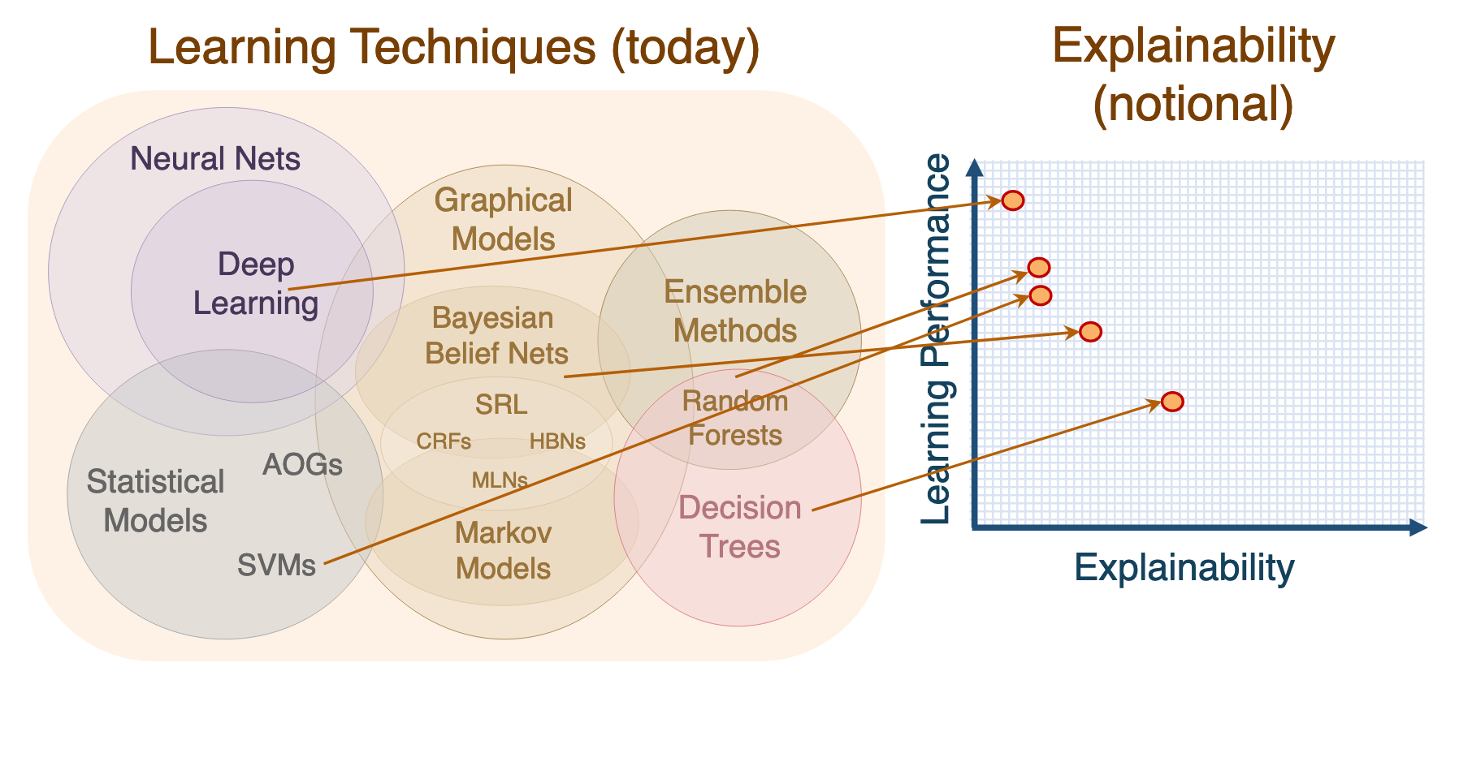
Is this graph accurate?
Notes:
https://www.darpa.mil/attachments/XAIProgramUpdate.pdf

Slide 25
Why bother with explanations/interpretations?
Algorithms can be wrong on examples that human operators get right
Algorithms can be working on outdated data (and have no way to handle “distributional drift”)
Explainable algorithms can further science
People are happier if they feel like they know what’s going on (even if they can’t control it)

Slide 26
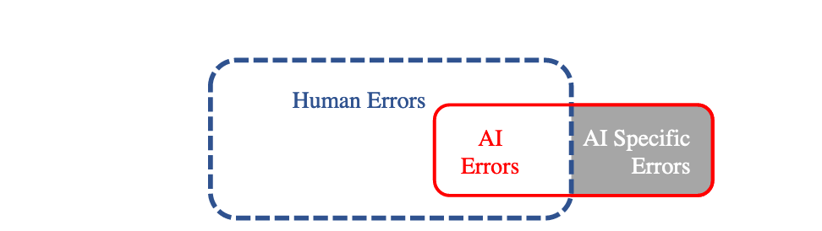

Slide 28
A less performant model may be more accurate if you include human operator.
We care about performance
of AI + human using it

Slide 29
Ways to explain
Questions:
Why did you do that?
Why not something else?
When do you succeed?
When do you fail?
When can I trust you?
How do I correct an error?
Hint: map questions to combinations of answers.
E.g. 1 -> [A+B]
Answers:
Simulation “run through decision process”
Decomposition “here’s the information I used to make decision”
Algorithmic transparency: “Here’s math that proves this algorithm will work, given large enough data”
Simplification: “My model is too complex to represent, but a simplified version is as follows…”
Examples: “Here are five other examples that are similar to this one that I classified the same way”

Slide 30
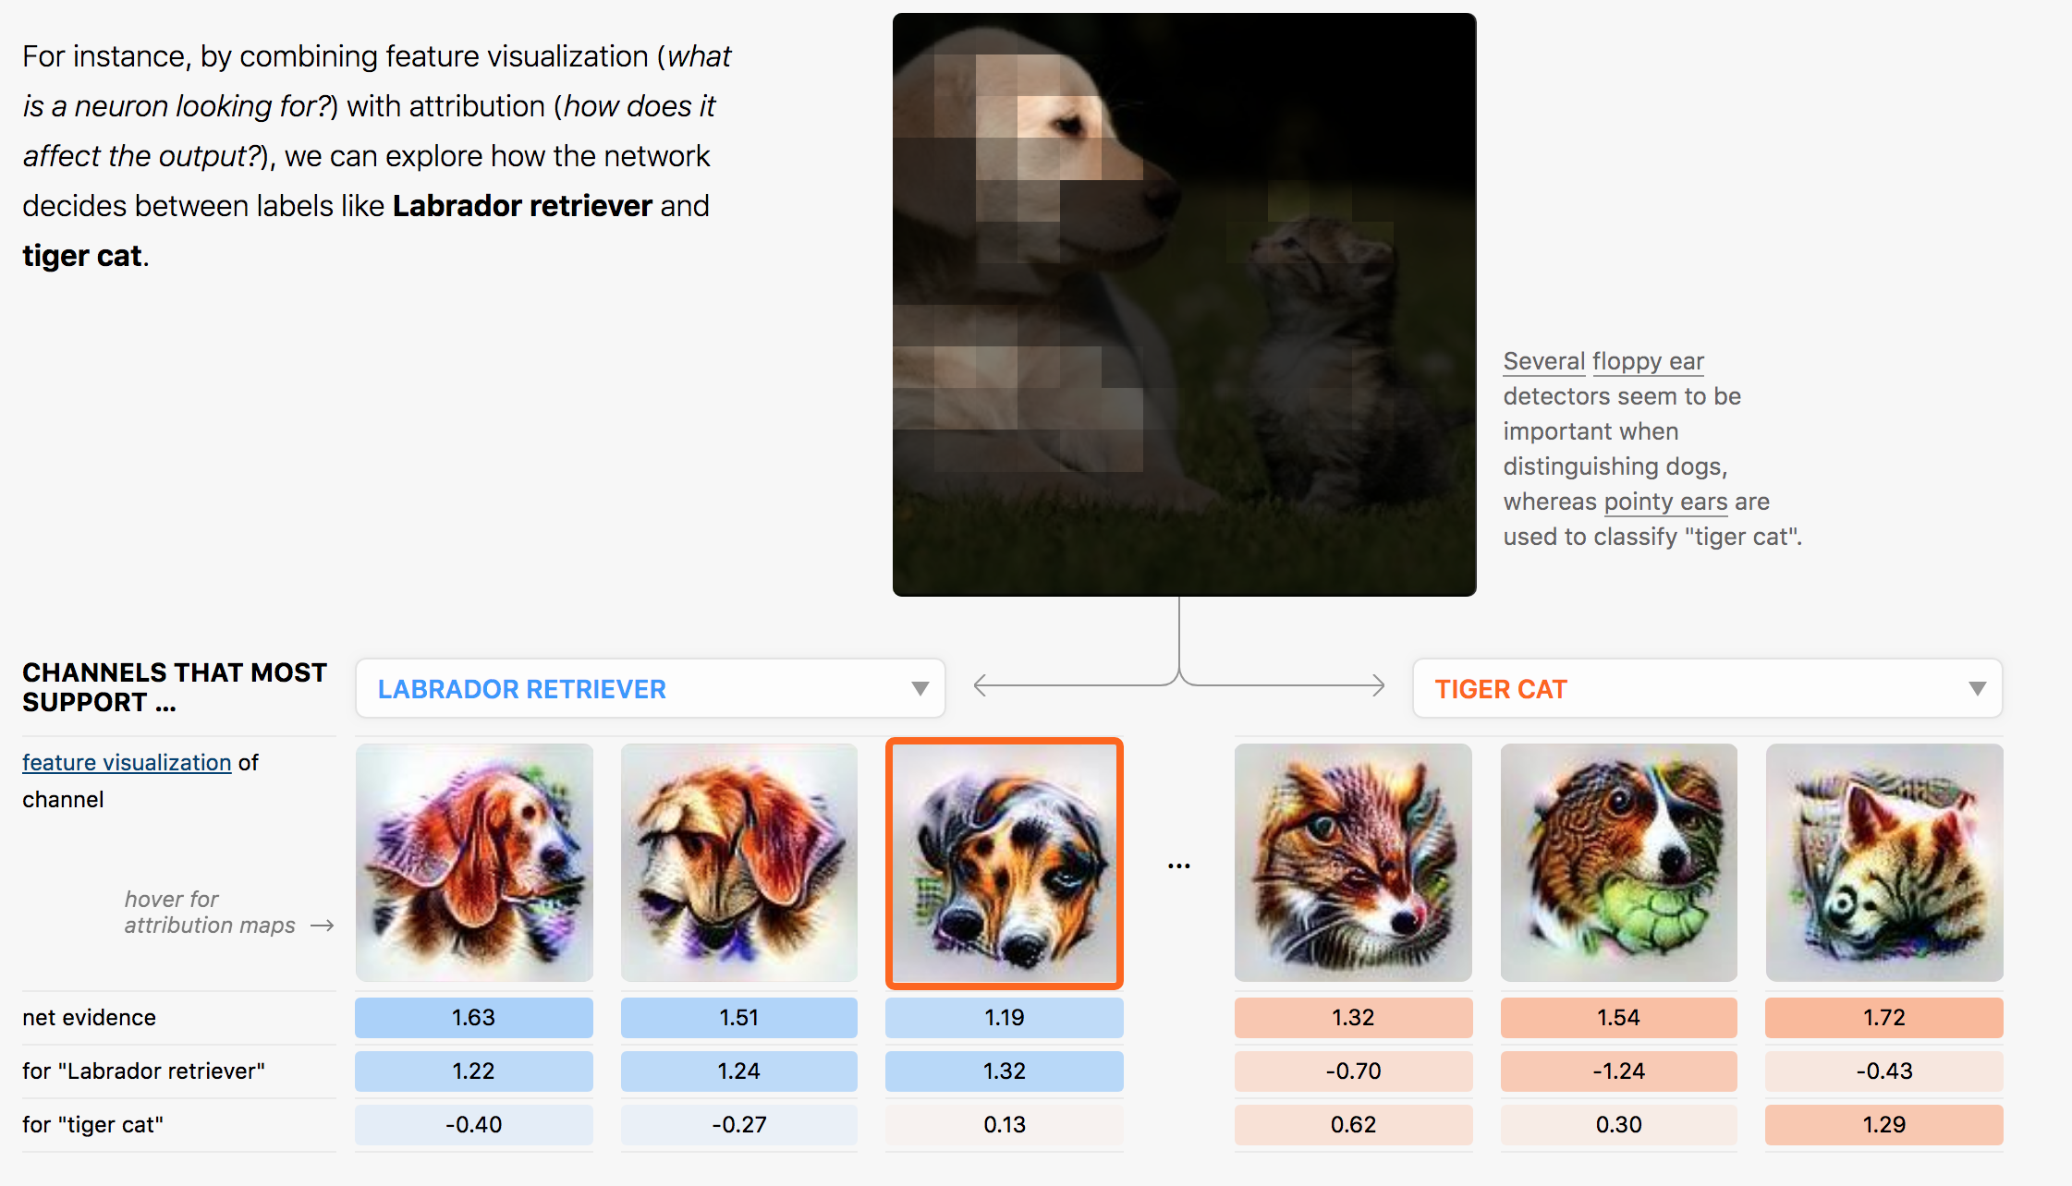
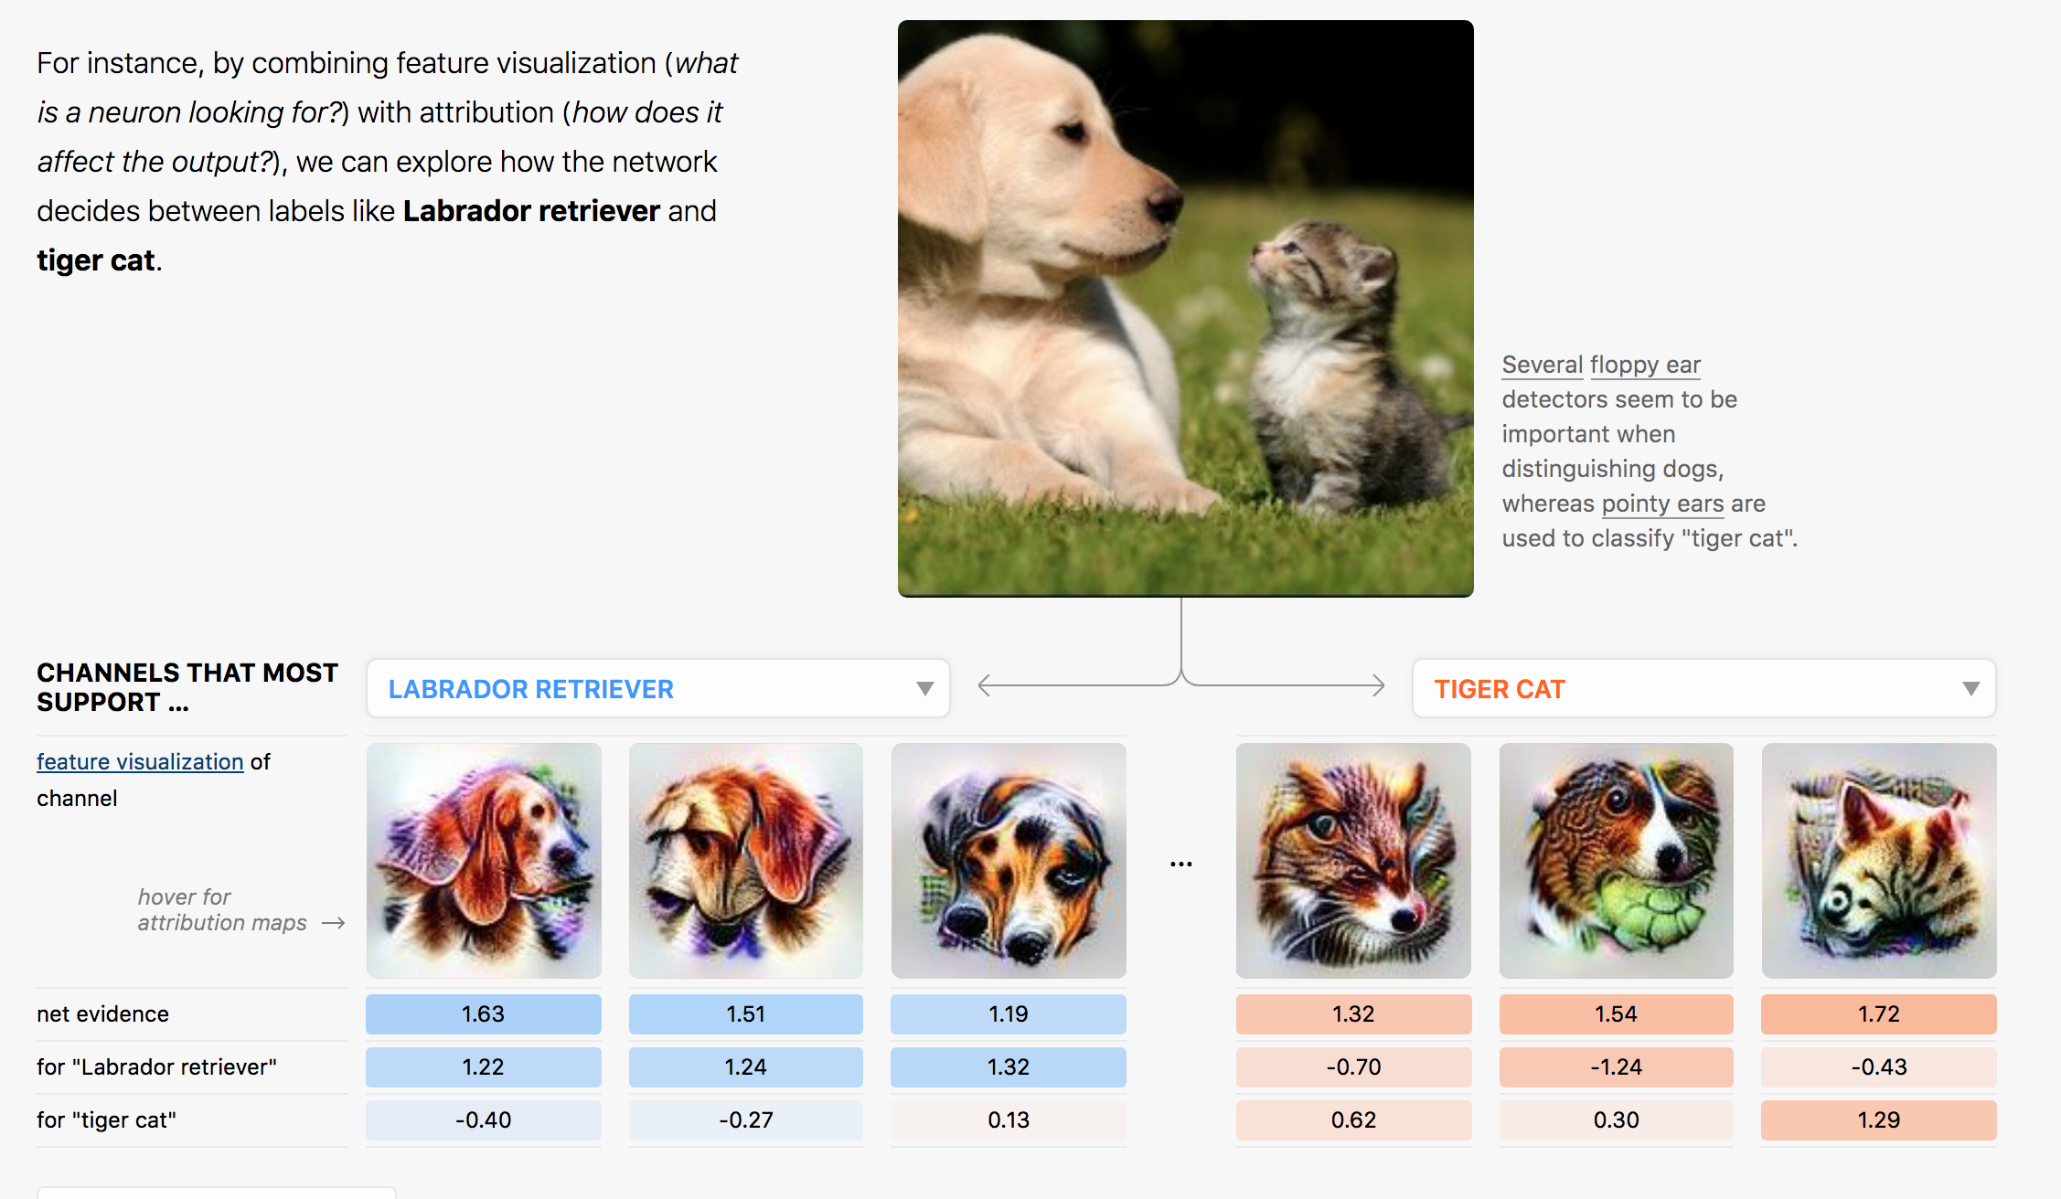
Combining multiple explanation modes
Decomposition
Simulation
Simplification
Notes:
From https://distill.pub/2018/building-blocks/

Slide 31

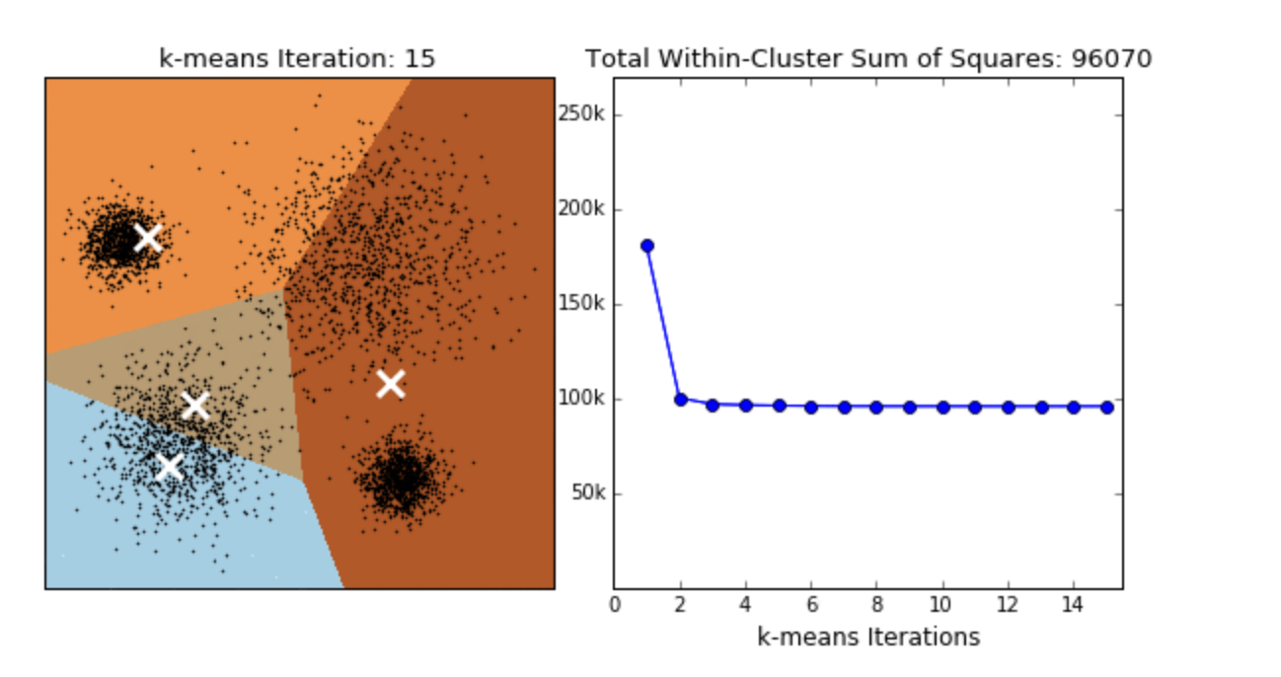
Knowing the underlying algorithm is also useful
How do you correct for bad predictions?

Slide 32
Design with the mind in mind
There seems to be a curious lack of focusing on how humans think in explanation work
When we talk about different explanation methods, ask yourself: how does this improve human cognition?
Answering this question helps you choose the right explanation mode

Slide 33
Design with the mind in mind -1: How people reason
System 1 thinking Fast, automatic, frequent:
determine that an object is at a greater distance than another
complete the phrase "war and ..."
Takes work to override. Brains are lazy.
(if you can’t remember which is System 1 vs. System 2, I can’t either -- I google it every time)
System 2 thinking:
Slow, conscious, infrequent:
“Give me a minute to think about it”
Park in a tight parking spot
Write a note for a project extension
Takes effort. => people are unable to do it if: tired, sleep deprived, task is repetitive, etc.

Slide 34
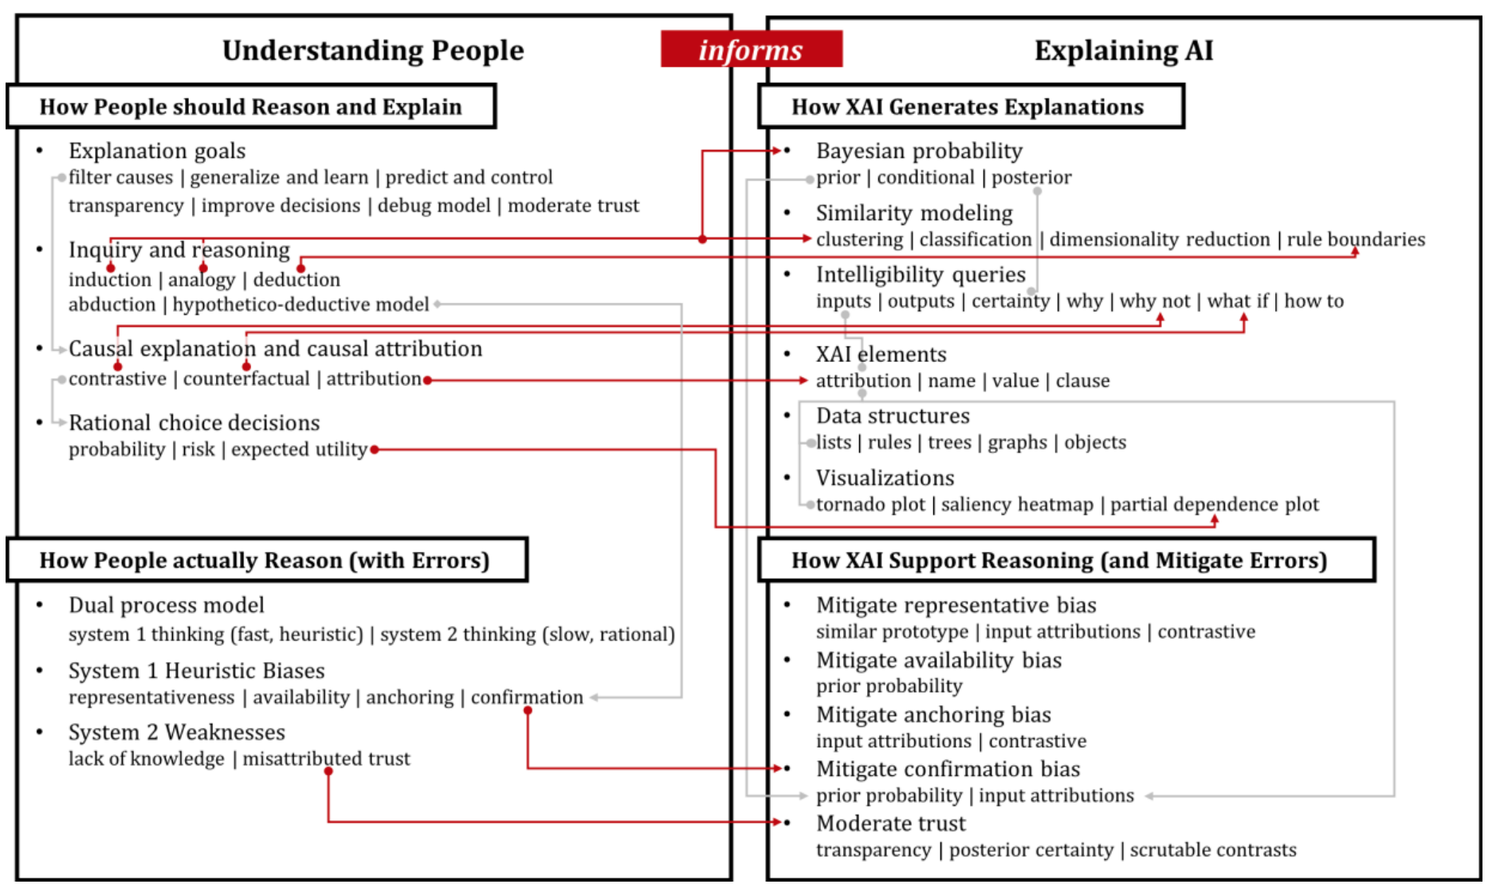
Notes:
http://www.brianlim.net/wordpress/wp-content/uploads/2019/01/chi2019-reasoned-xai-framework.pdf

Slide 35
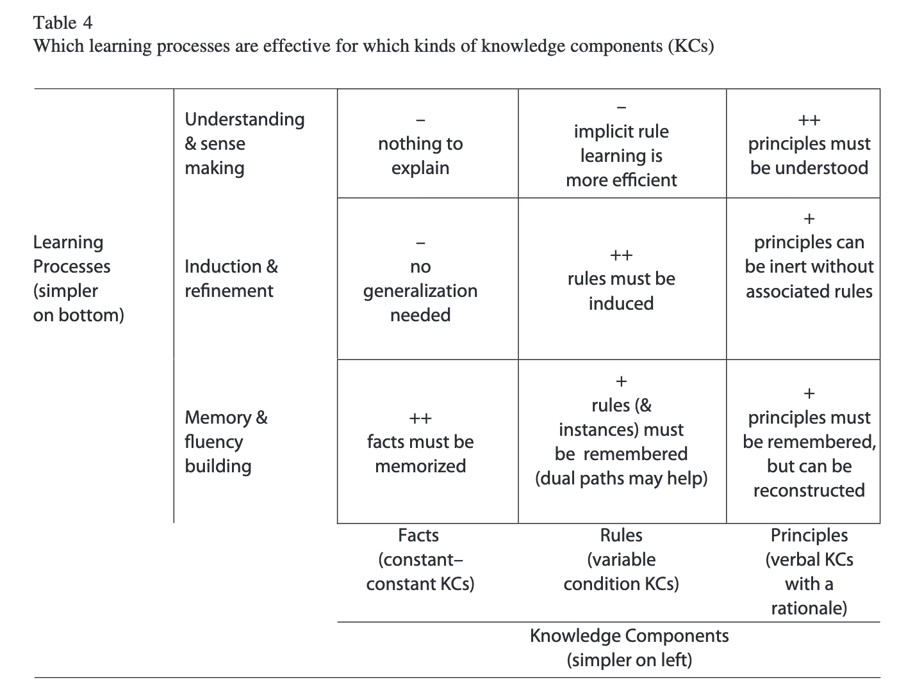
Designing with the mind in mind -2: How people learn
Notes:
From http://pact.cs.cmu.edu/pubs/Koedinger,%20Corbett,%20Perfetti%202012-KLI.pdf

Slide 36
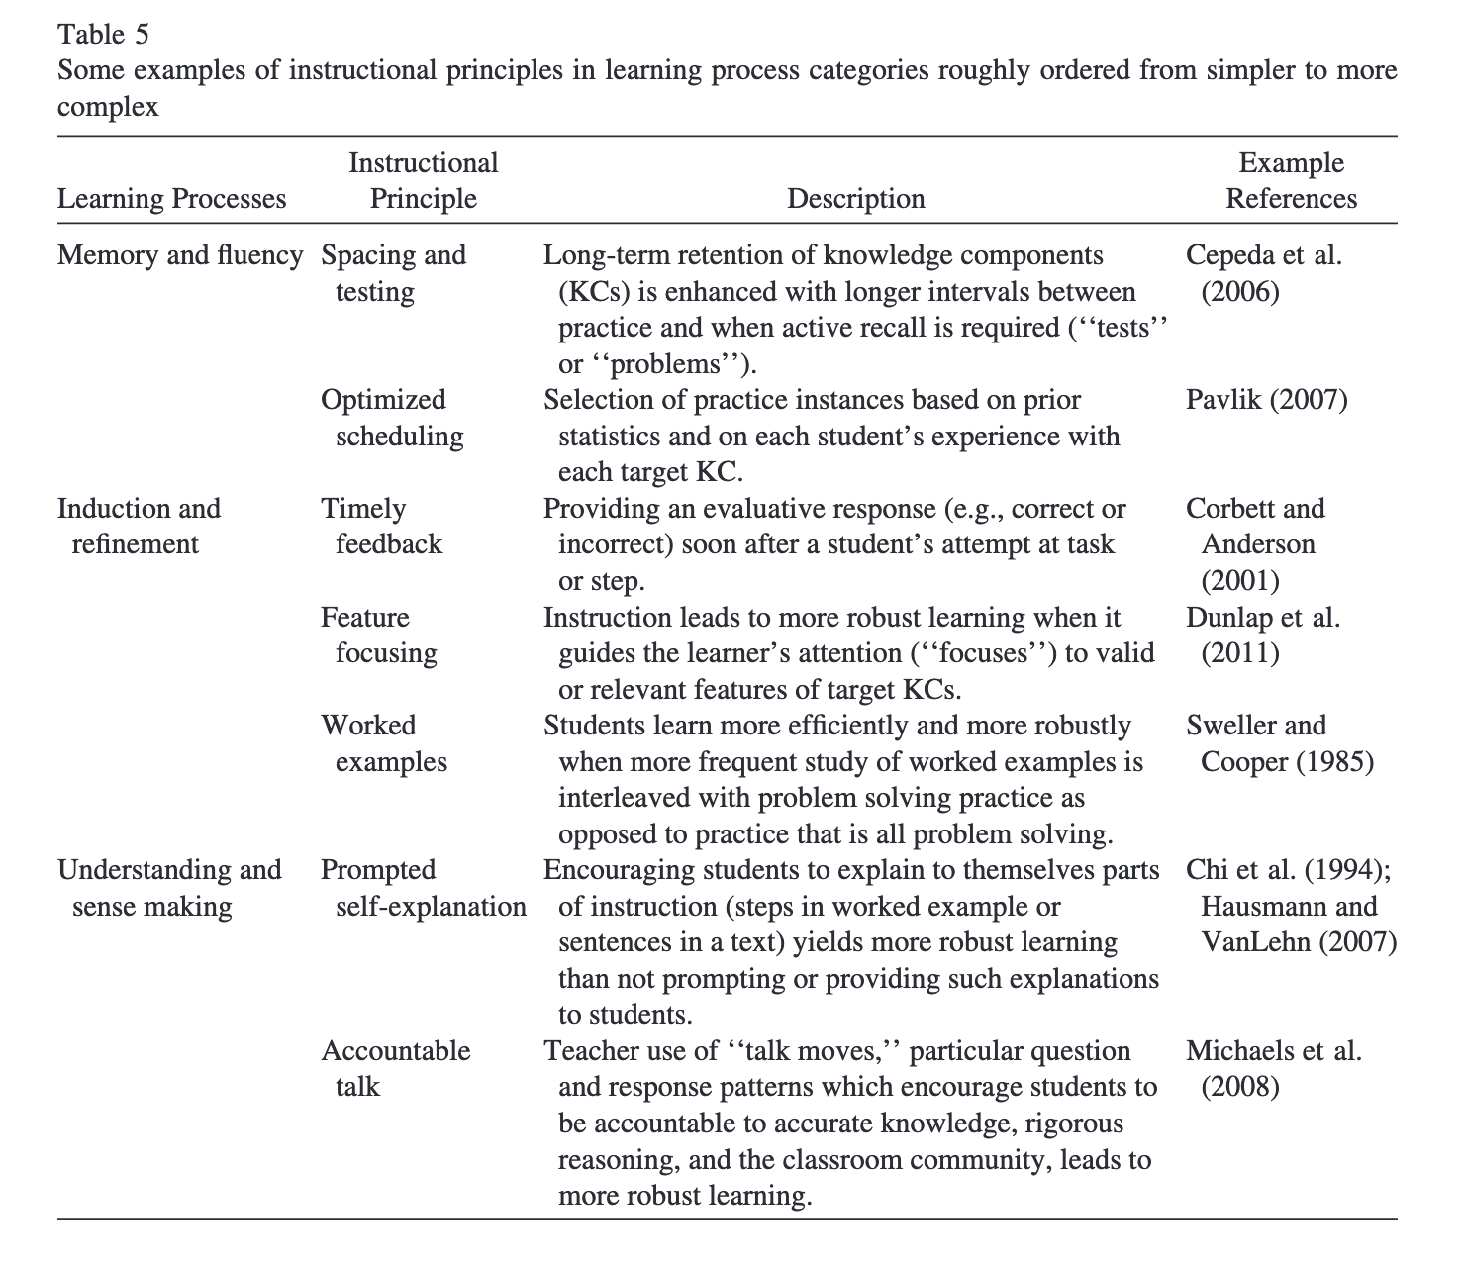
Designing with the mind in mind -2: How people learn
Notes:
From http://pact.cs.cmu.edu/pubs/Koedinger,%20Corbett,%20Perfetti%202012-KLI.pdf

Slide 37
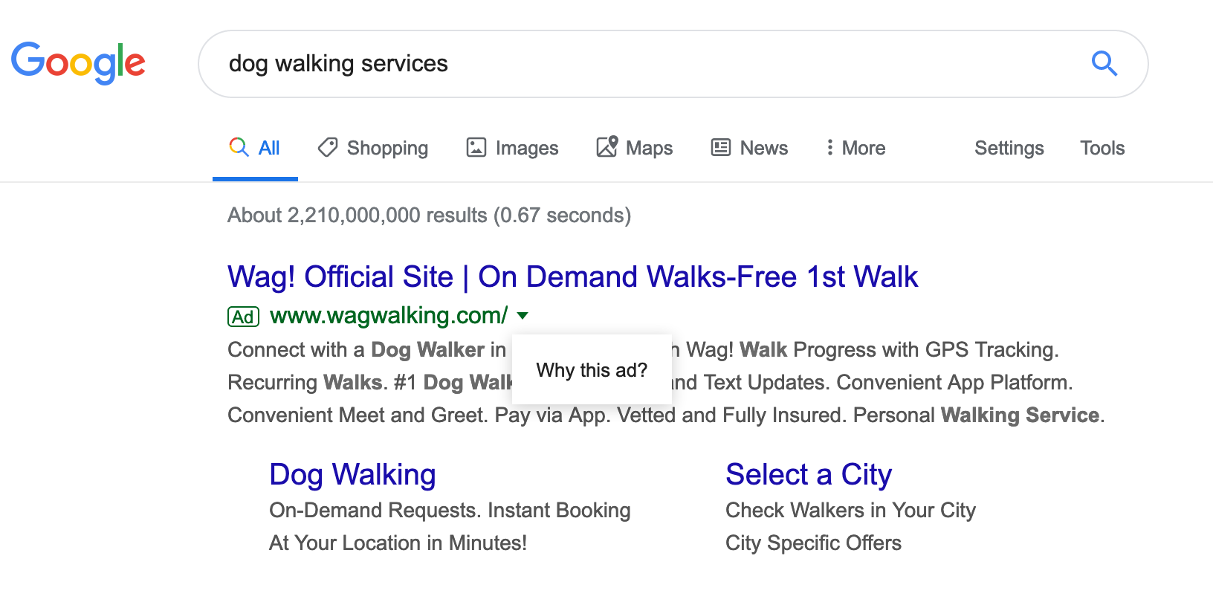
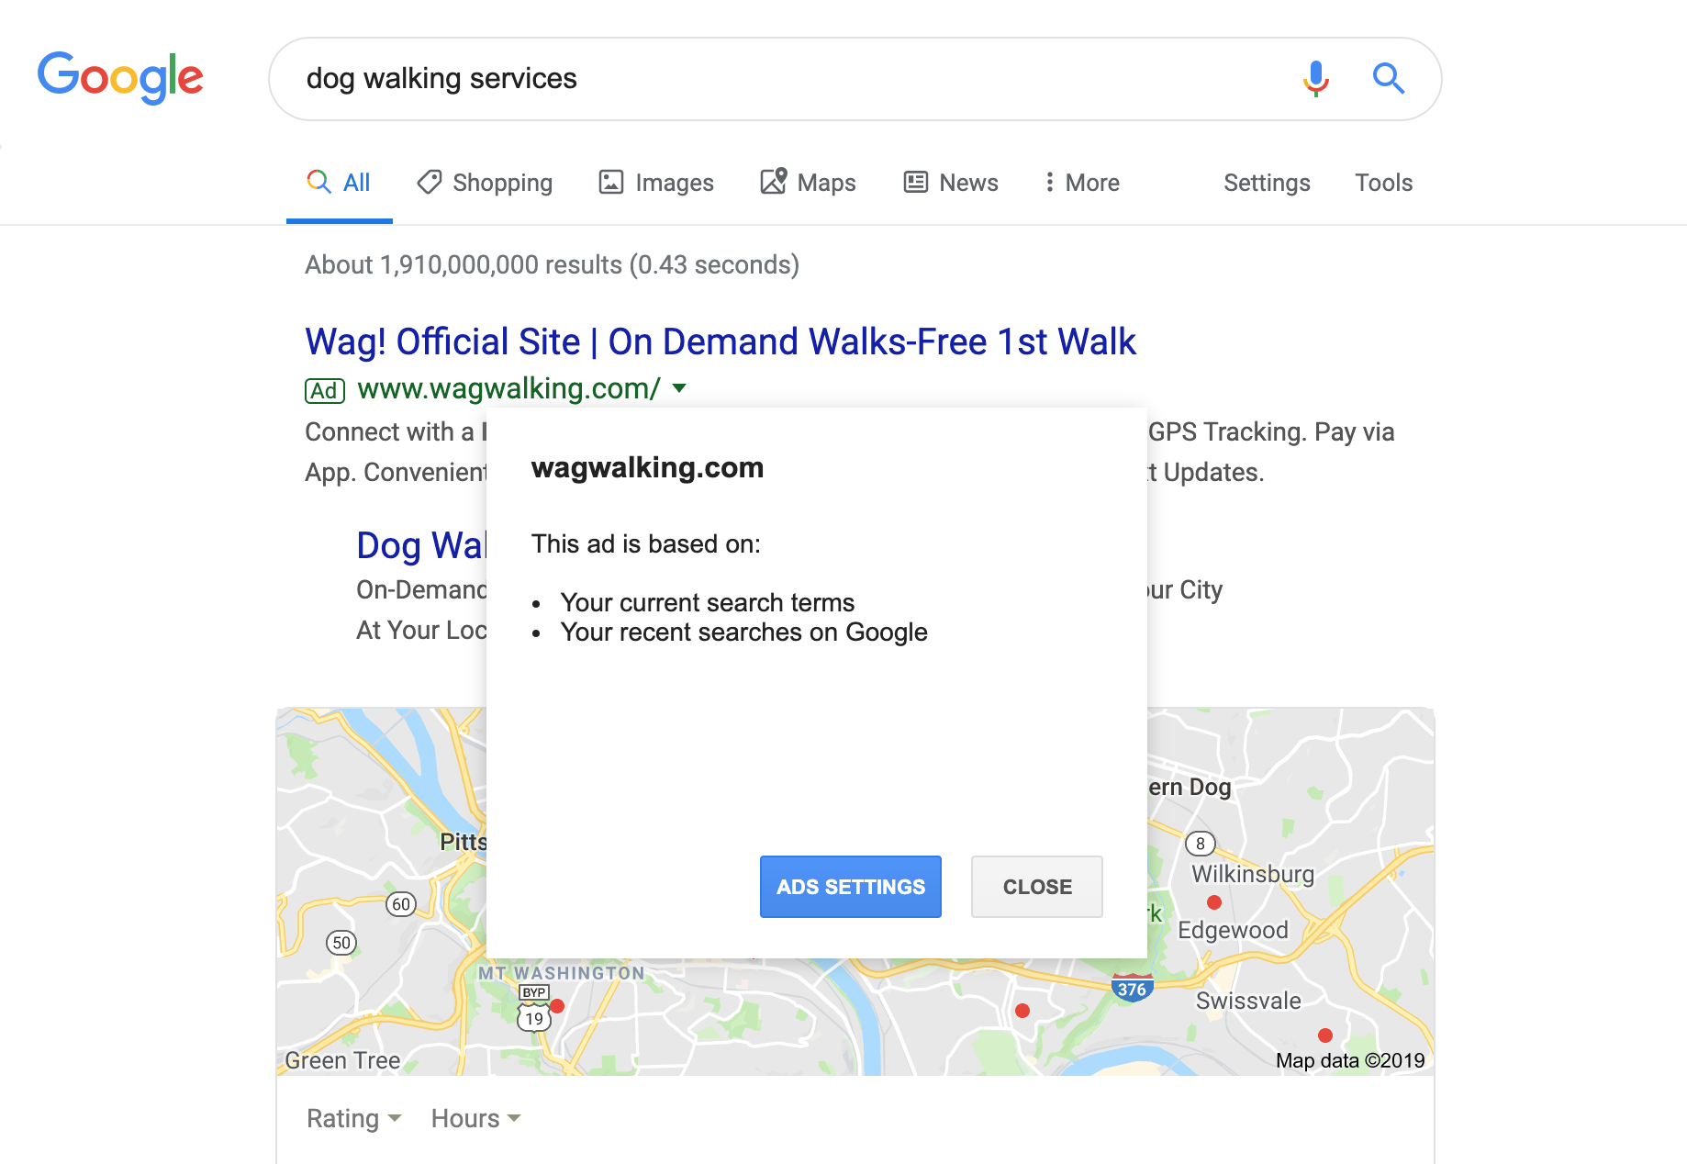
What kind of knowledge is this explanation providing?

Slide 38
What kind of reasoning do we expect post-explanation?

Slide 39
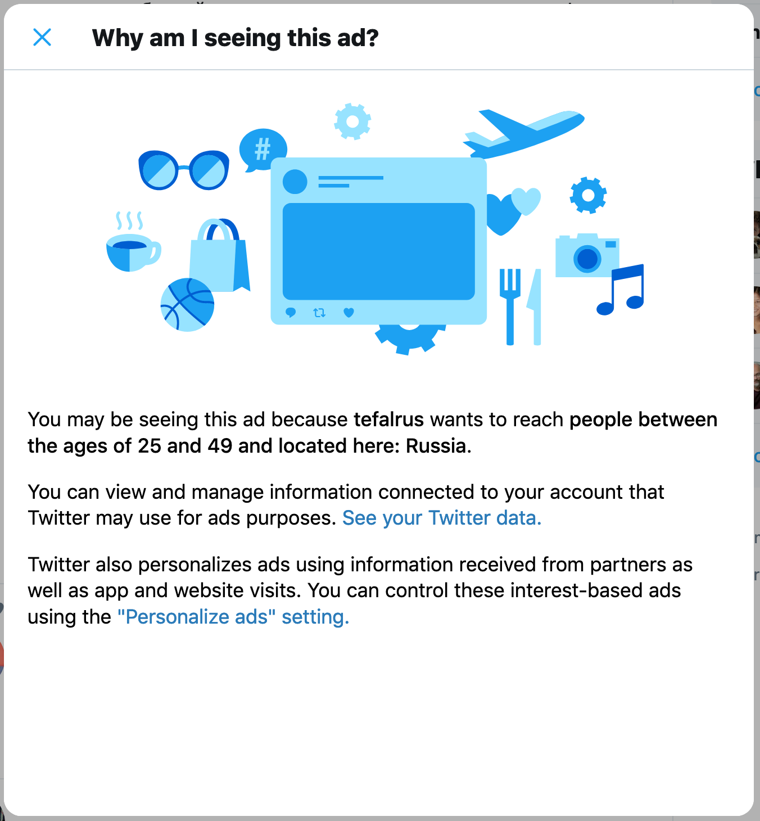
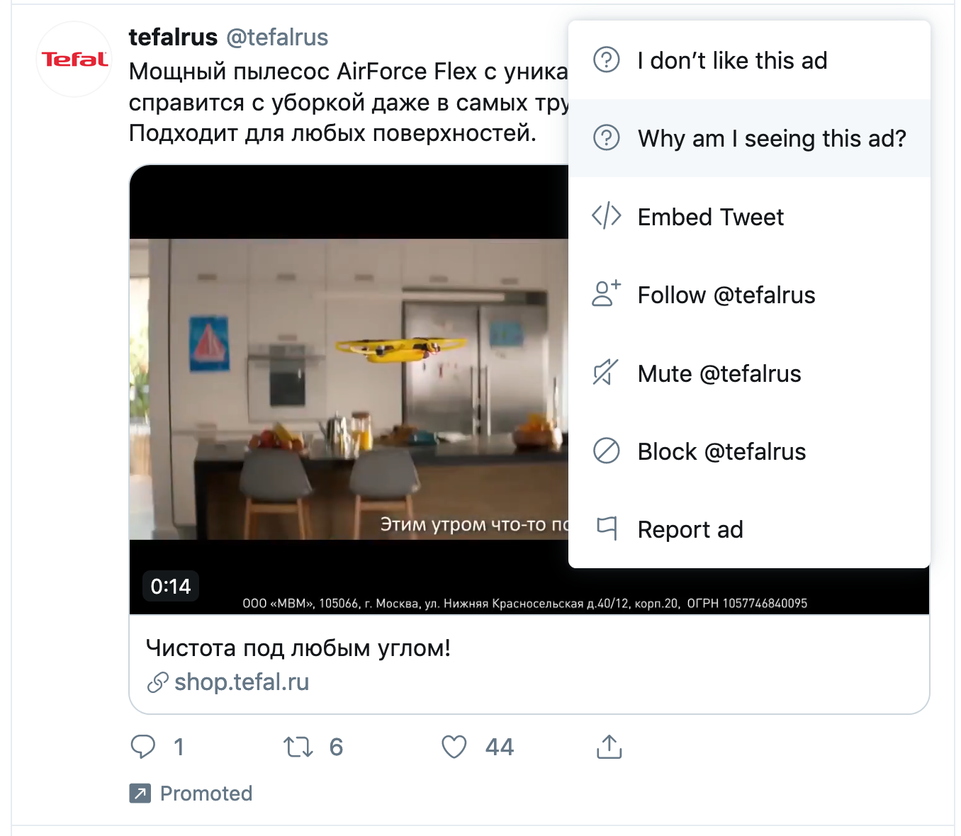
What kind of knowledge is this explanation providing?

Slide 40
What kind of reasoning do we expect post-explanation?

Slide 41
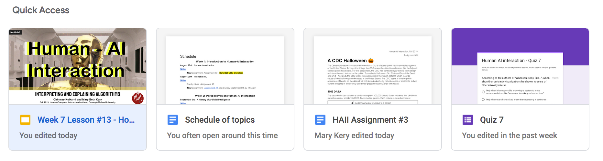
What kind of knowledge is this explanation providing?

Slide 42
What kind of reasoning do we expect post-explanation?

Slide 43
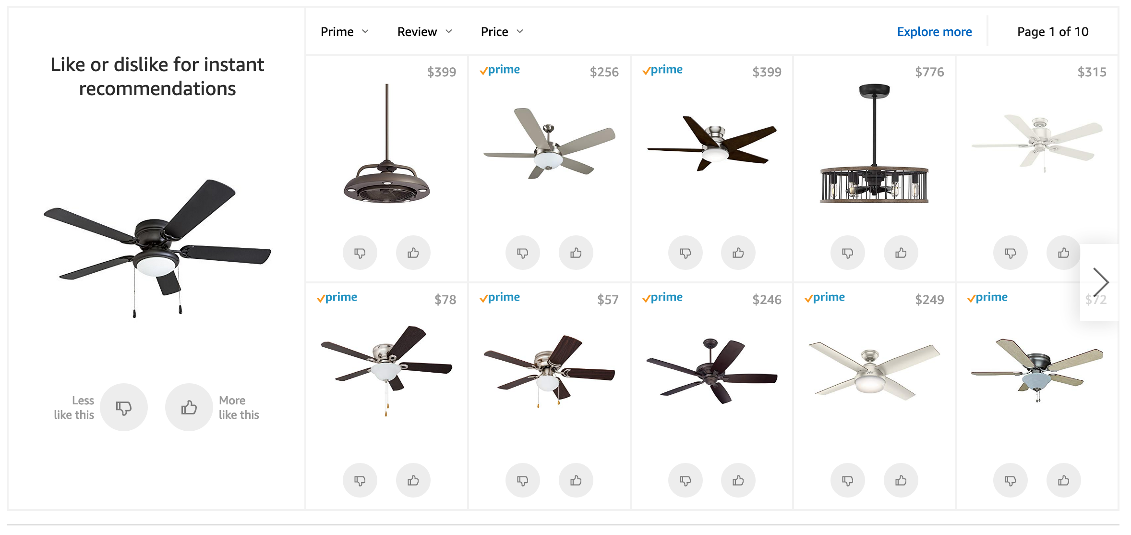
What kind of reasoning do we expect post-explanation?

Slide 44
What kind of knowledge is this explanation providing?

Slide 45
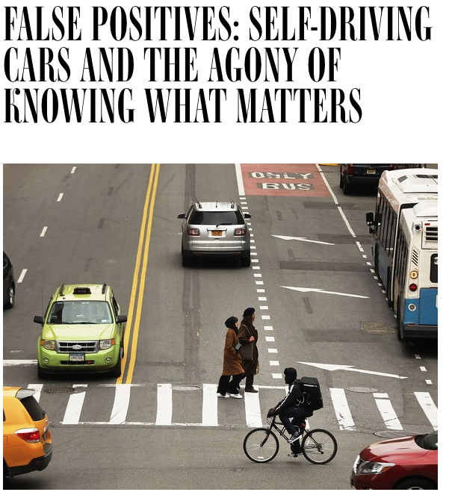
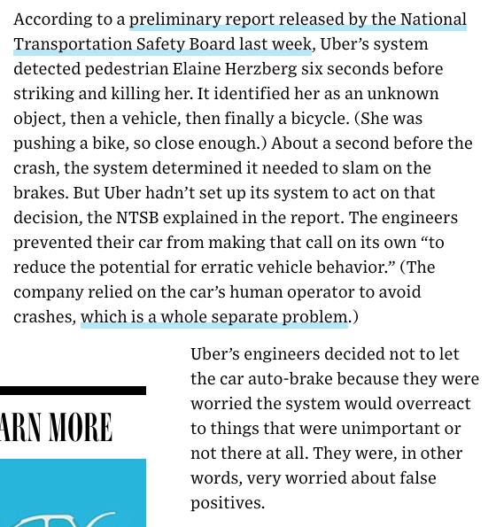
What kind of knowledge would be useful here?
https://www.wired.com/story/self-driving-cars-uber-crash-false-positive-negative/

